Slide 1
Multiple Testing, P-Hacking, Reproducibility Crisis, Publication Bias
Zitao Zeng and Gloria Givler

Slide 2
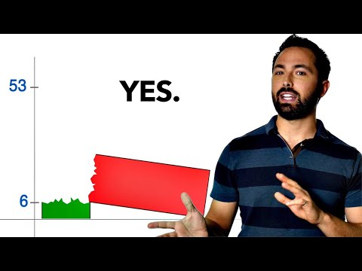
Introducing the Concepts

Slide 3
Multiple Testing
Explanation, Paul the Octopus, Genomic Case Study
1

Slide 4
What is the Multiple Testing Problem?
Multiple testing refers to performing statistical inference tests across many variables without accounting for the number of tests performed
A p-value of 0.05 might be fine for one test
But if you perform a hundred tests, you will end up with on average five false positive results!
How can you correct for this phenomenon?

Slide 5
The Family-Wise Error Rate
Family-wise error rate (FWER) is the probability of making one or more false discoveries, or type I errors when performing multiple hypotheses tests.
 | Null hypothesis is true (H0) | Alternative hypothesis is true (HA) | Total
Test is declared significant | V | S | R
Test is declared non-significant | U | T | m-R
Total | m0 | m-m0 | m

Slide 6

The Bonferroni Method
If a trial is testing m=20 hypotheses with a desired α=0.05, then the Bonferroni correction would test each individual hypothesis at α=0.05/20=0.002. Likewise, when constructing multiple confidence intervals, the same phenomenon appears.

Slide 7
False Discovery Rate (FDR)
FDR is the ratio of the number of false positive results to the number of total positive test results
Same as the expected proportion of type 1 errors
FDR is the essence of the multiple testing problem, which started to be recognized as an issue in the 90s and early 2000s with the rise of big data

Slide 8
Controlling for the FDR
One can perform many hypothesis tests while accounting for the multiple testing problem
Doesn’t try to avoid any false positives
The goal is to make sure that the ratio of false positives to total positives is “small enough”.

Slide 9
Choosing an FDR Threshold
Very context-dependent; there is no widely accepted "right" threshold
like an alpha-level of 0.05 or 0.01
If the planned follow-up analysis is time-consuming or expensive, a 10% FDR threshold might be appropriate
If it’s critical to catch any potential significant factors, and the follow-up analysis is inexpensive, one might choose 30% as the threshold

Slide 10
The Benjamini-Hochberg Procedure
Algorithm 13.2 from An Introduction to Statistical Learning
Specify q, the level at which to control the FDR.
Compute p-values, p1,...,pm, for the m null hypotheses H01,...,H0m.
Order the m p-values so that p(1) ≤ p(2) ≤ ··· ≤ p(m).
Define L = max { j : p(j) < qj/m }.
Reject all null hypotheses H0j for which pj ≤ p(L).

Slide 11
The Benjamini-Hochberg Procedure Explained
Rejects all null hypotheses for which the p-value is less than or equal to the Lth smallest p-value
L is a function of all m p-values
Can't plan in advance what the threshold will be, since it depends on the data collected
Good method of correcting for the multiple testing problem; still relatively simple to understand and perform

Slide 12
Paul the Octopus
2010 FIFA World Cup
German octopus named Paul became famous for correctly "predicting" the outcome of every match Germany played, plus the final match
Paul’s owners put two food boxes in his tank
Each was labeled with the flag of one of the countries playing in the upcoming match
The box Paul chose to eat from first was taken as his prediction for the winner

Slide 13
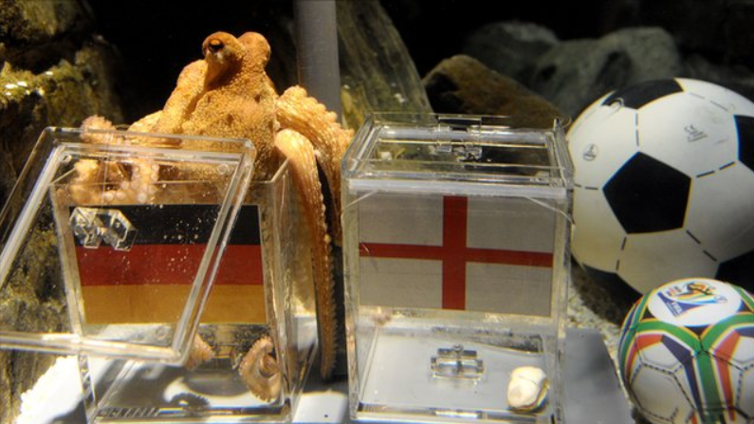
Paul the Octopus

Slide 14
Paul, Explained
Assuming Paul was randomly guessing, he only had a 1/256 chance of getting them all right
p = 0.0039, < widely accepted alpha-level of 0.05
Many animals across the globe were asked to predict these matches
When accounting for number of animals participating, the odds that at least one of them would predict correctly were closer to 9%

Slide 15
Case Study 1 Dataset
Cancer Statistics in US States database from Kaggle
272 patients and 1555 gene expression levels
Attribute columns:
Patient
ID
Age
eventdeath: represents whether the patient died after treatment (0: alive; 1: dead).
survival: survival time (year)
time recurrence: time interval when cancer cells reappear
7-17. tumor related information
18-1573. gene expression levels

Slide 16
Case Study 1 Objective
Different gene expression levels may affect breast cancer and the ability of patients to heal
Detecting the key genes is helpful to:
Select appropriate treatment methods
Speculate on the patient’s condition during the rehabilitation period
Aim is to identify genes that have an significant impact on the death of breast cancer patients

Slide 17
Case Study 1 Conclusion
It is easy to obtain a large number of false positive results by comparing multiple genes of the same group of patients
If 1555 genes are tested without adjustment, we will get 607 positive results
There are a lot of false positives among them
The expression of many genes affects each other
We utilized the Bonferroni adjustment, and reduced the number of possible genes to 96 by the Bonferroni Method and 443 by the Benjamini-Hochberg Procedure

Slide 18
P-Hacking
Definition, Strategies, Prevention, Grades Case Study
2

Slide 19
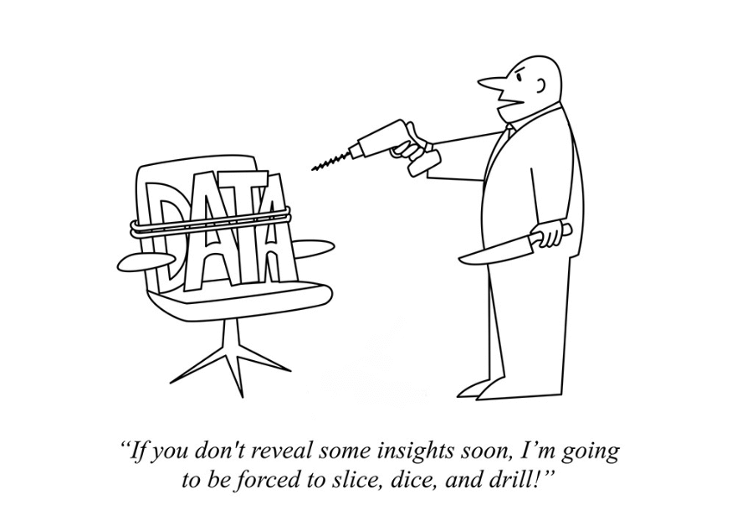
What is P-Hacking?
Performing statistical analysis in a way that makes non-significant data relationships appear significant

Slide 20
How Does P-Hacking Happen?
Most people think that researchers performing p-hacking are doing so intentionally
They try many analysis methods in sequence
Fishing for statistically significant findings
Not every researcher even knows they’re p-hacking
There are many different valid ways to analyze
It is easy to justify your choices in hindsight
P-hacking can occur due to human error and subconscious bias

Slide 21
Most Common P-Hacking Strategies
Selective reporting of the dependent variable
Selective reporting of the independent variable
Optional stopping, aka data peeking
Repeatedly computing hypothesis tests as data points are collected; stopping data collection once a significant result is achieved
Outlier exclusion (reduces the stdev of a data pool)
Exploiting alternative hypothesis tests
Adding or relaxing assumptions
Changing parametrization of the model

Slide 22
Pre-Registration of Studies
A procedure that protects against p-hacking
Has gained steam over the past decade or two
Detailed plans on how data will be analyzed are created in advance of the data collection
Researchers are forced to follow their earlier decisions
Prevented from being able to try out different collection and analysis methods in order to find an artificially significant result

Slide 23
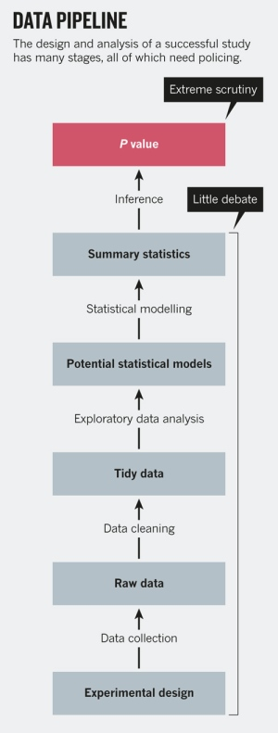
How P-Hacking Escapes Unnoticed
People evaluate whether a study has significant findings based solely on the p-value.
They do not consider the other steps taken that contribute to that p-value.
Just because p < 0.05 does not mean that the results are necessarily true.

Slide 24
Case Study 2 Dataset
Thought experiment using a dataset of 1000 rows of randomly generated numbers 1-100
Data points represent student's final exam grades in math classes at Pitt

Slide 25
Case Study 2 Objective
Students at Pitt have complained that departmental finals for math courses cause too many students to fail
Imagine you are the department chair; you want to find evidence to disprove this claim
You decide to go to the engineering students, as they are known to have good math scores
You will take a sample of them to analyze, to prove that there is no issue with students being able to succeed on math finals

Slide 26
Case Study 2 Conclusion
With such a small p-value, you can easily reject your null hypothesis–there is statistically no way the mean final exam score is below 60% (failing grade)
But the “grades" are just random numbers 0 -100,
The true population mean is close to 50
Students would absolutely be justified in complaining if these were real grades
This thought experiment is an extreme example, which shows the danger of uncritically accepting a low p-value as a good result

Slide 27
Reproducibility Crisis
Definition, Explanation of Low-Power Studies
3

Slide 28
What is the Reproducibility Crisis?
In recent years, it’s been discovered that the results of many reputable scientific studies using widely accepted experimental methods are difficult or even impossible to reproduce
Calls into question the credibility of those studies
If the results cannot be replicated, findings may be based on random chance and not a true cause-and-effect relationship

Slide 29
Causes Behind the Reproducibility Crisis?
Mostly due to publication bias and low-power studies
Publication bias will be discussed in more detail in the next section
“Low-power studies" refers to the statistical power of the hypothesis test

Slide 30
What is Statistical Power?
The probability that a hypothesis test correctly rejects a false null hypothesis
Inversely related to the probability of a type II error
Power depends on three factors:
Effect size: the magnitude of the difference between two or more treatments
Sample size
Variability of the sample

Slide 31
Impact of Statistical Power on Studies
Low-power studies have high risk of type II error
Type II error = incorrectly failing to reject the null when it actually is false
Extreme values are required in order to trigger a statistically significant finding in the study
When a statistically significant finding is made, it may appear to have a bigger effect size than the true difference between the groups
A statistical power of 0.8 is seen as a good target value to eliminate this bias

Slide 32
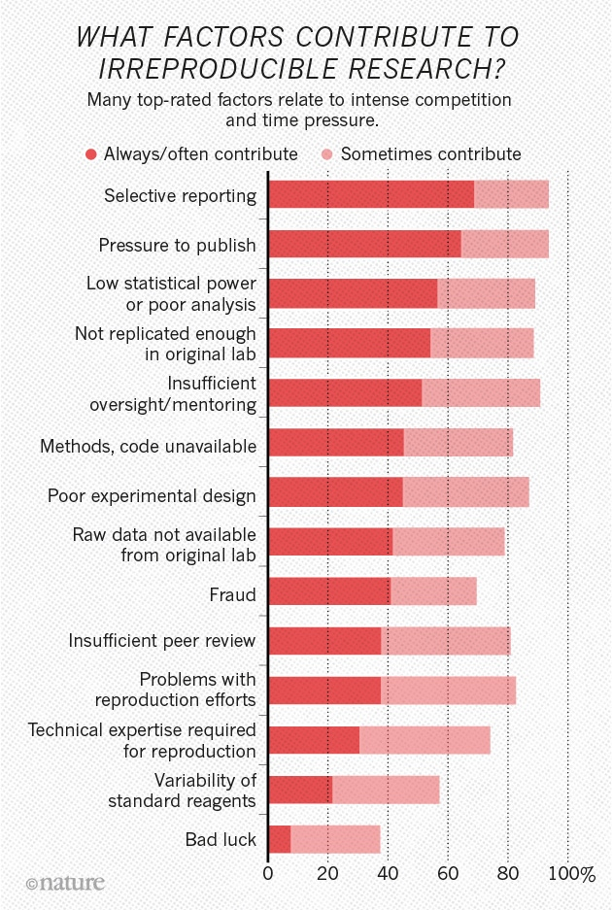
Causes of Reproducibility Crisis
1,576 researchers were surveyed in 2016
The top 3 contributing factors were related to either publication bias, low-power studies, or p-hacking

Slide 33
Publication Bias
Definition, Contributing Factors, Impact
4

Slide 34
What is Publication Bias?
The scientific version of "if it bleeds, it leads"
Sensational, violent stories are prioritized in the news, because they draw viewers' attention
Journals are interested in publishing groundbreaking research and new discoveries
This affects the research papers they accept

Slide 35
Causes of Publication Bias
Biggest contributing factors to publication bias:
Rejection by journal editors and reviewers
Lack of interest to revise the research paper
Competing interests
Lack of motivation to write a research paper
Many scientists consider research with negative or neutral results a failure
As long as methodology was sound, findings are meaningful, even if not desired outcome

Slide 36
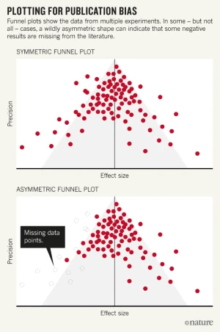
Effect of Publication Bias
Upper plot represents true distribution of findings around a mean effect size
Lower plot represents all findings present in literature
Assumptions solely off of published research would conclude that the effect is greater than it truly is

Slide 37
Data in Fabrics of Society
5

Slide 38
Publication Bias in Hedge Funds
US hedge funds are not very strictly regulated
There is no law requiring them to report their performance
If they’re doing well, voluntarily reporting their performance may attract new investors
When a fund is underperforming, it won’t report
Publicly reported hedge fund performances therefore overestimate the true returns of the hedge funds
Potentially by up to 60%, according to a 2012 study

Slide 39
Other Bias in Hedge Funds
There is also a survivorship bias issue in hedge fund performance databases.
Databases only supply information on funds that are still in operation
If a fund was not doing well and was closed, it is not represented in the data
This further artificially inflates the performance of hedge funds as an investment class
See this Forbes article for more info

Slide 40
The Cost of Multiple Testing and P-Hacking
Multiple testing and p-hacking can both lead to false discoveries, which are harmful and expensive
Monetary cost of irreproducible preclinical medical research was >28 billion dollars per year according to a study done in 2015
Approximately 35.7 billion dollars today

Slide 41
The True Cost
There is also a scientific/ethical cost to false discoveries
They slow down the search for lifesaving cures by wasting researchers' time
Can also give baseless hope to patients waiting for breakthroughs that could save their lives
Being aware of these issues and taking steps to mitigate their effects is critical to avoiding unintended consequences
See this article on why so many clinical trials for pharmaceutical R&D fail

Slide 42
References
Reproducibility Crisis Infographic
Publication Bias Infographic
Causes of Publication Bias Article
Data Pipeline Infographic
Multiple Testing Comic
Inflation Calculator
An Introduction to Statistical Learning with Applications in R, 2nd edition

